Slide 1
Forget Me Not Team Meeting #9
Cassady, Gardone, Suter

Slide 2
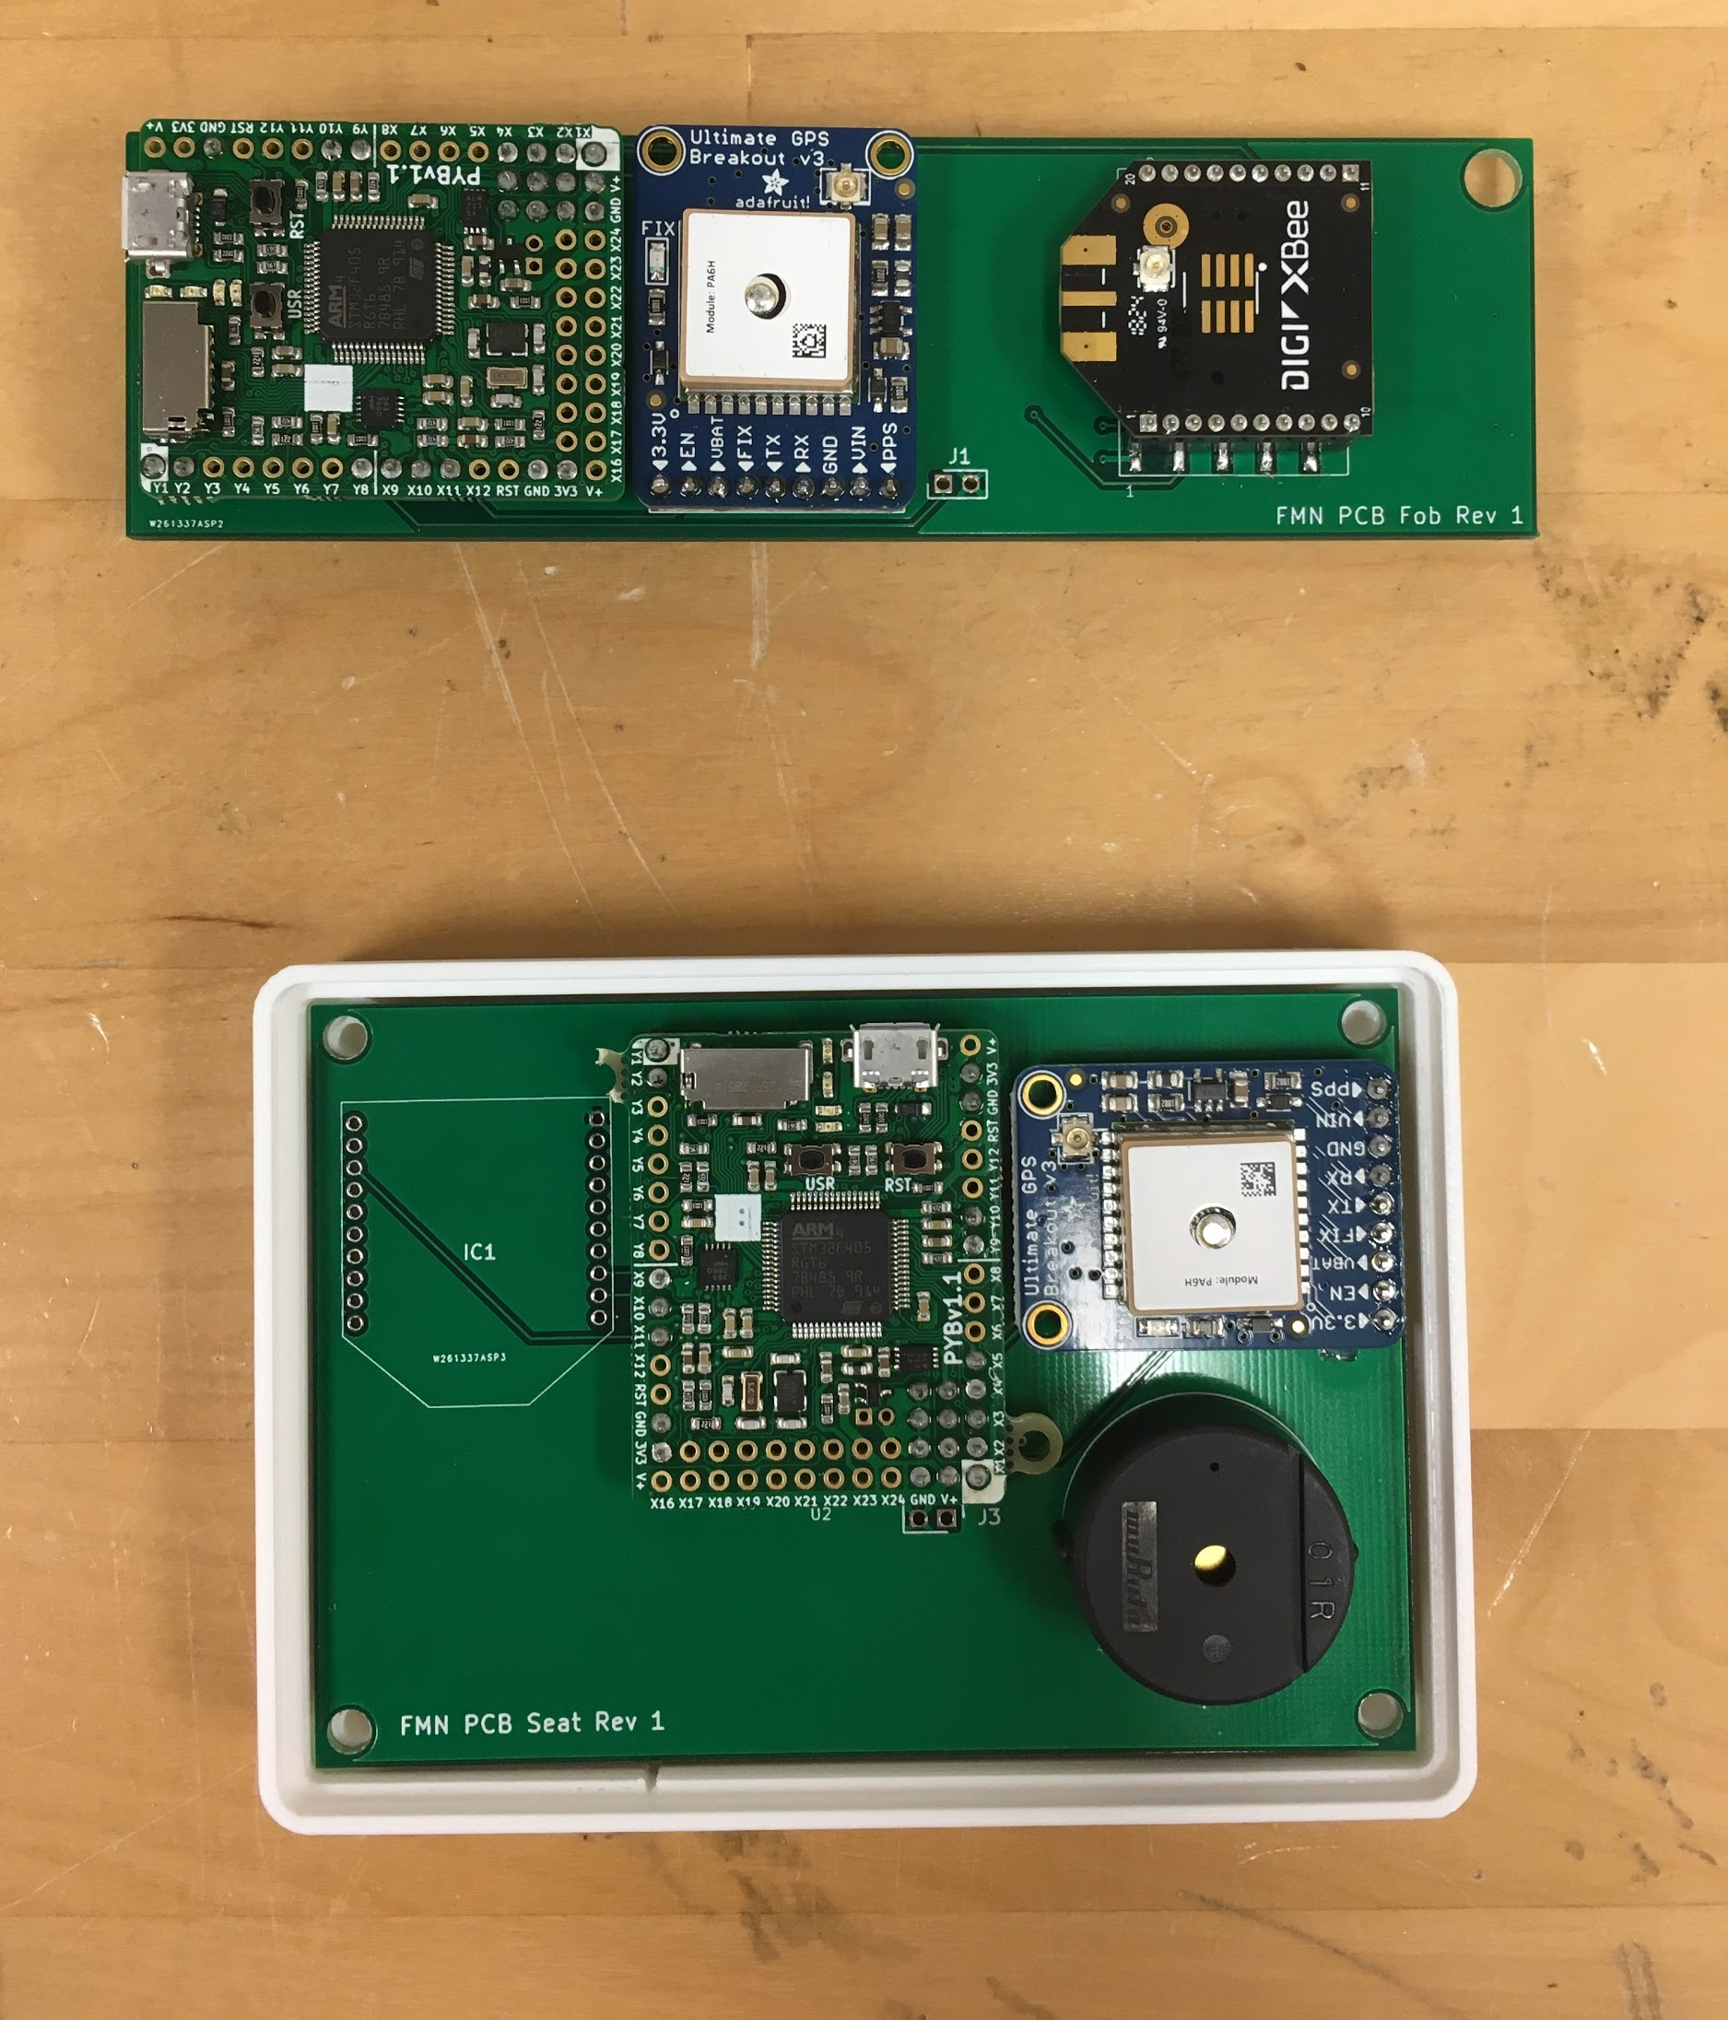
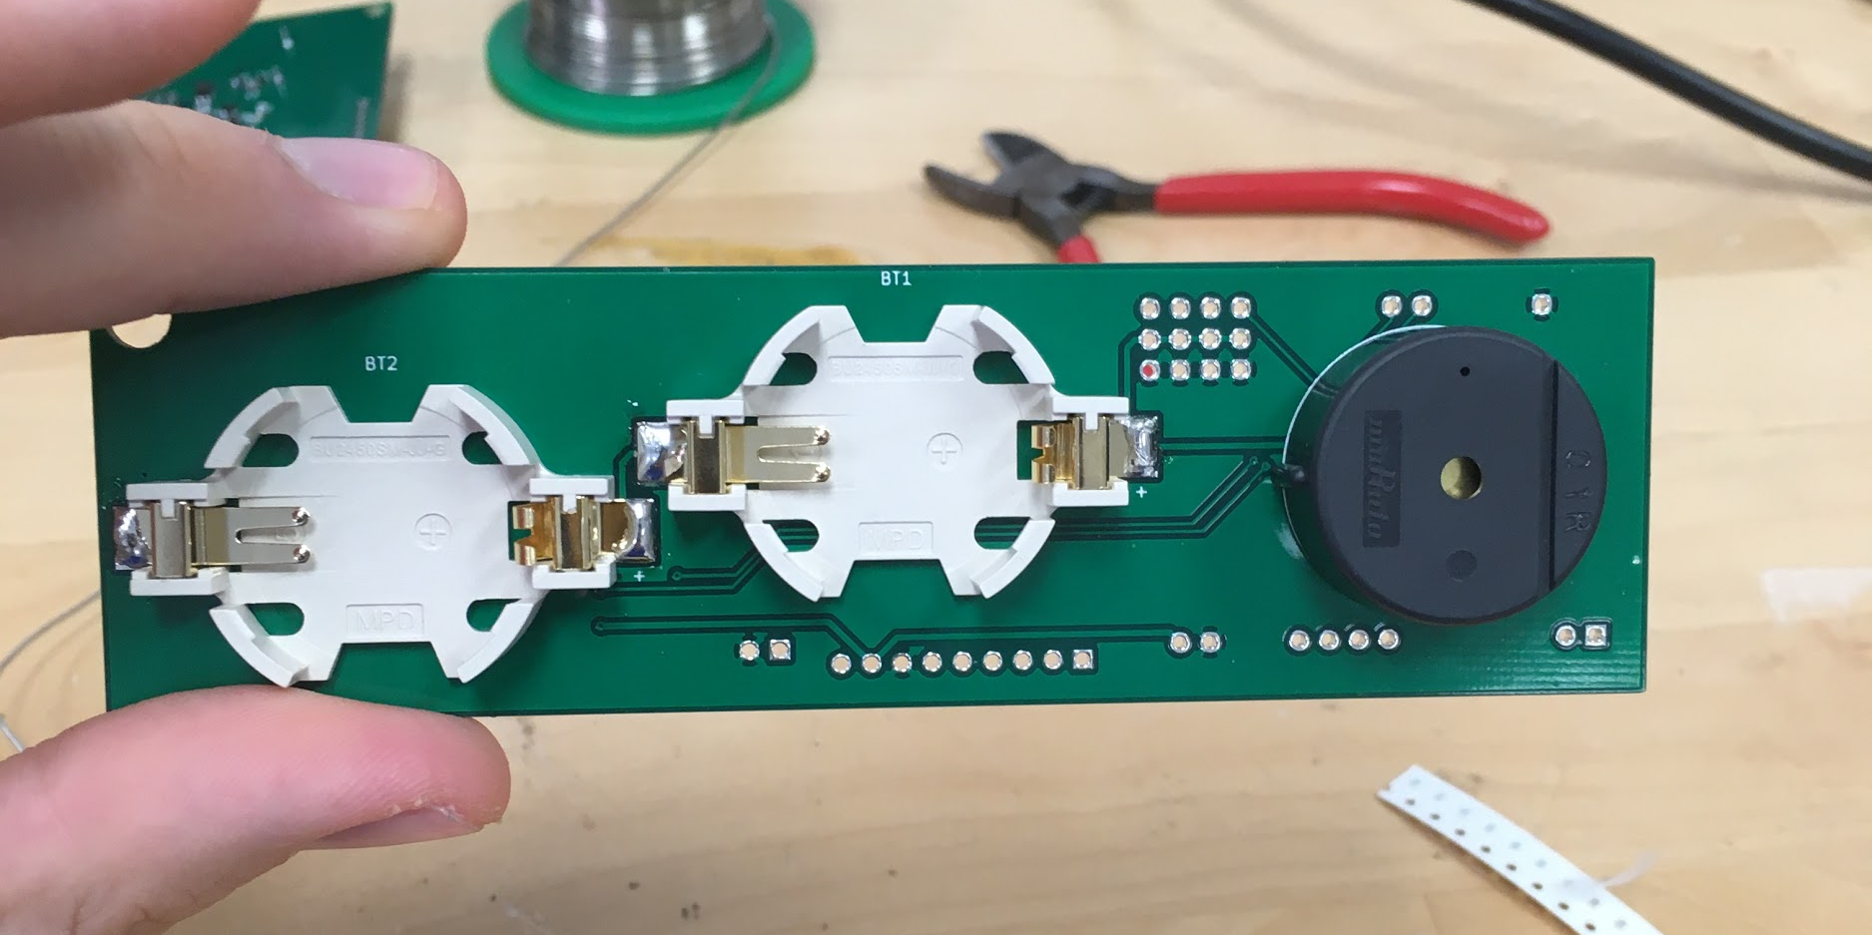
PCBs - Mason
I have soldered most of the components on both boards.
The RF module on the car seat subsystem needs to be programmed before being soldered.
Also the battery pack and vibration motor have not been solder as they need to be attached to the case.
Sorry I could not make the meeting.

Slide 3
Software
Continued to implement full system now that it’s soldered together.
Tested speaker using software

Slide 4
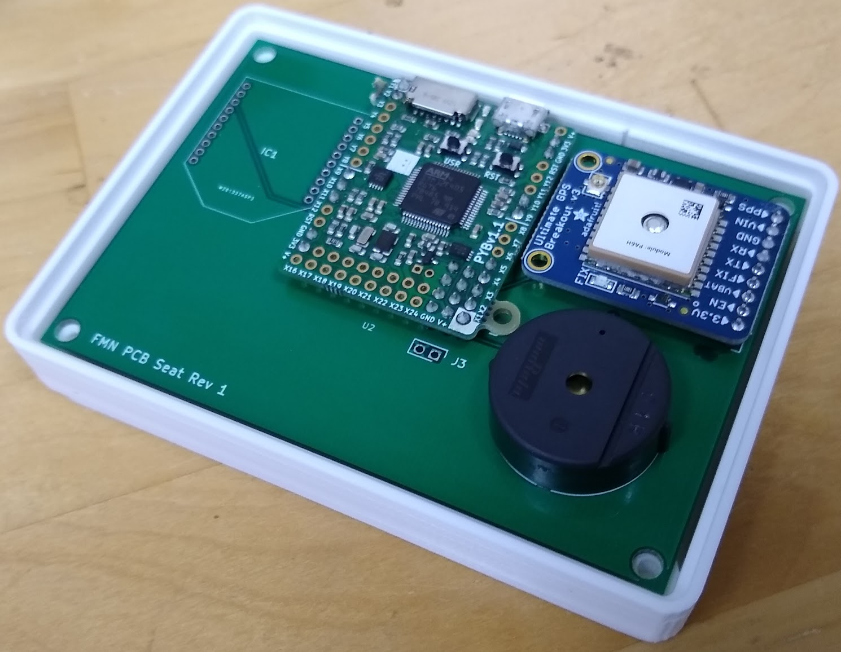
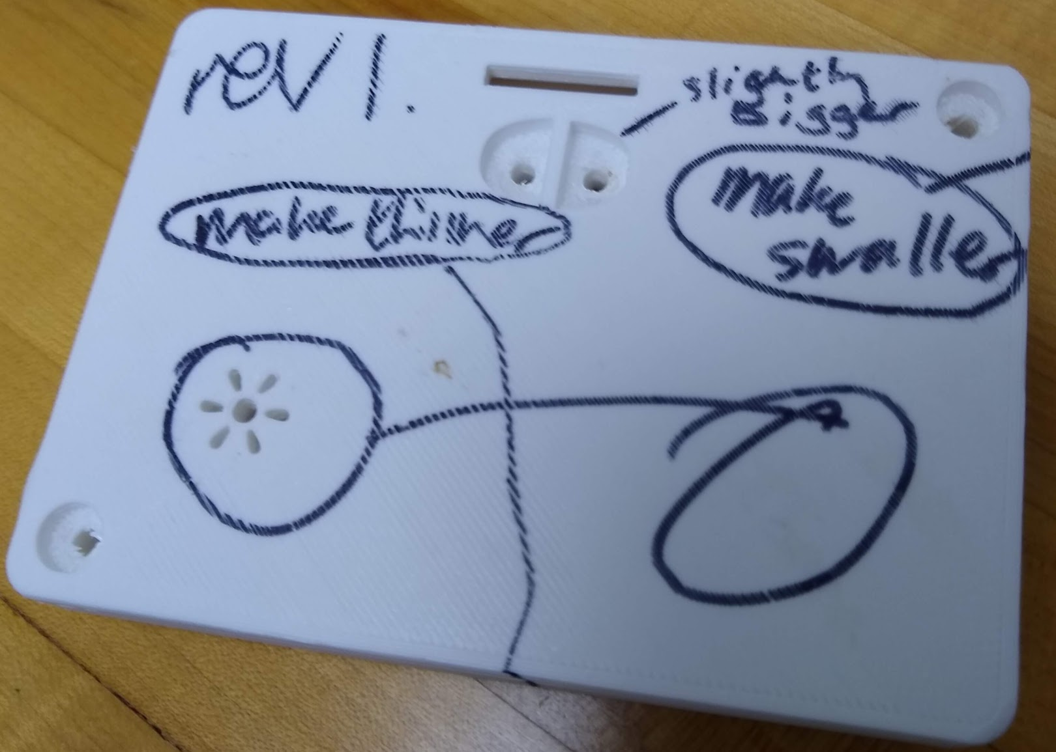
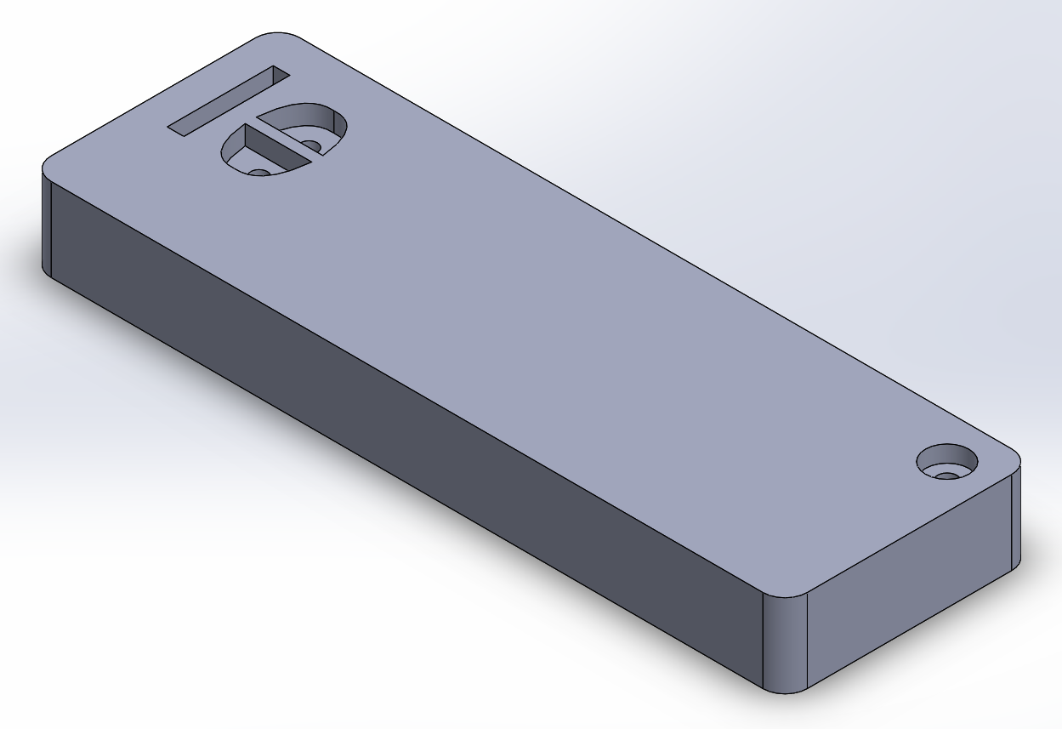
Casing
Carseat case finished printing.
Need screws (ship to store at Home Depot)
Verify Push button stem length
Keyfob case started printing
Finalize design
Latch for battery cover?
Snap? What size screws/where to get?

Slide 5
Plans
Finish Case design
Receive screws, put system together physically before Thanksgiving break.
Issues
Battery cover

